Slide 1
All-ChatRoom
Ron Alexis / Joshua Alkins / Jason Charles
190904 / 190908 / 190906

Slide 2
Introduction
All-Chat is a messaging application in development.
The application aims to be a major source of communication and sharing for the users in today’s current market.
Just as the major players: Whatsapp & WeChat, the app allows for messenging, file sharing, live location sharing and many more features!

Slide 3
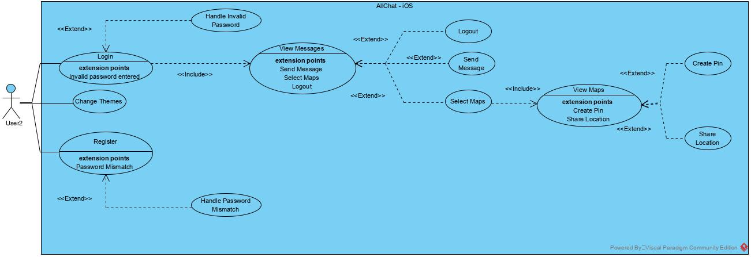
Use Case Diagram

Slide 4
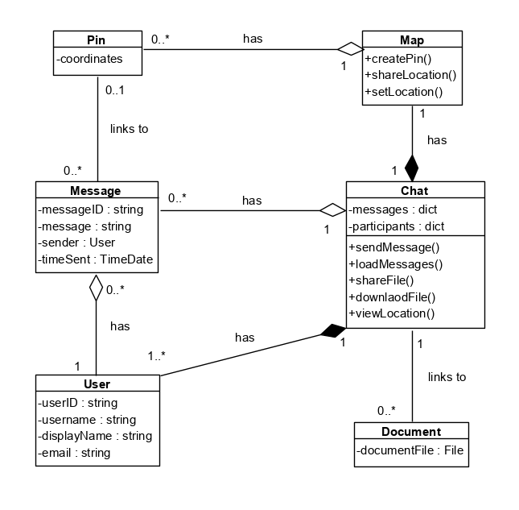
CLASS DIAGRAM

Slide 5
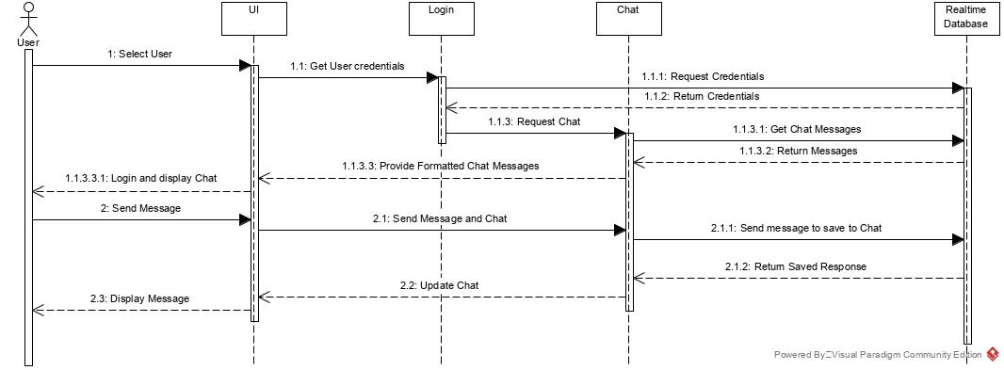
SEQUENCE DIAGRAM: Send Message

Slide 6
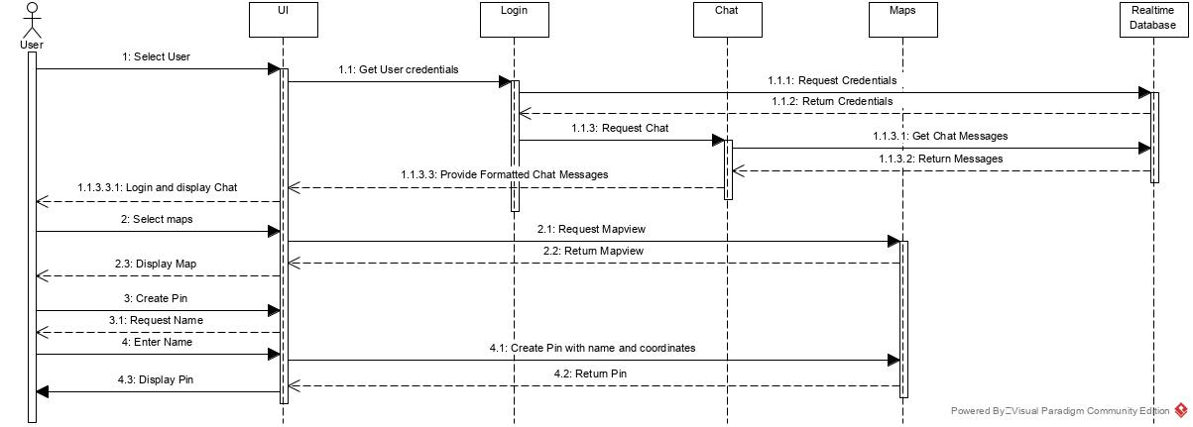
SEQUENCE DIAGRAM: Create Pin

Slide 7
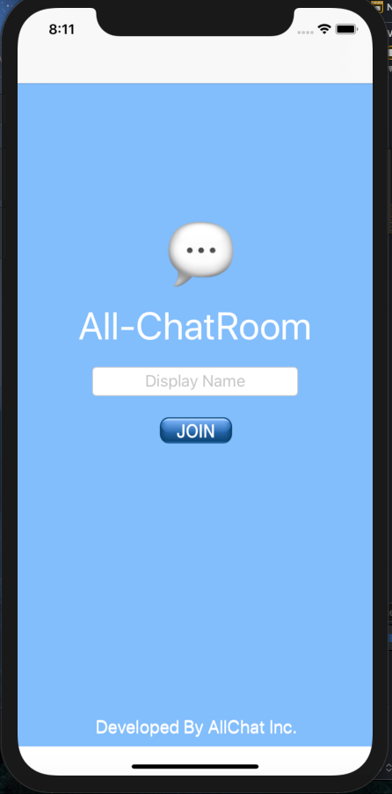
Features
Login
Send/Receive Messages
Themes
Sounds
Notifications
Register Users
Maps
File Sharing Implementation
Storage Navigation
Logout
Icon
Online Storage
Database Connectivity

Slide 8
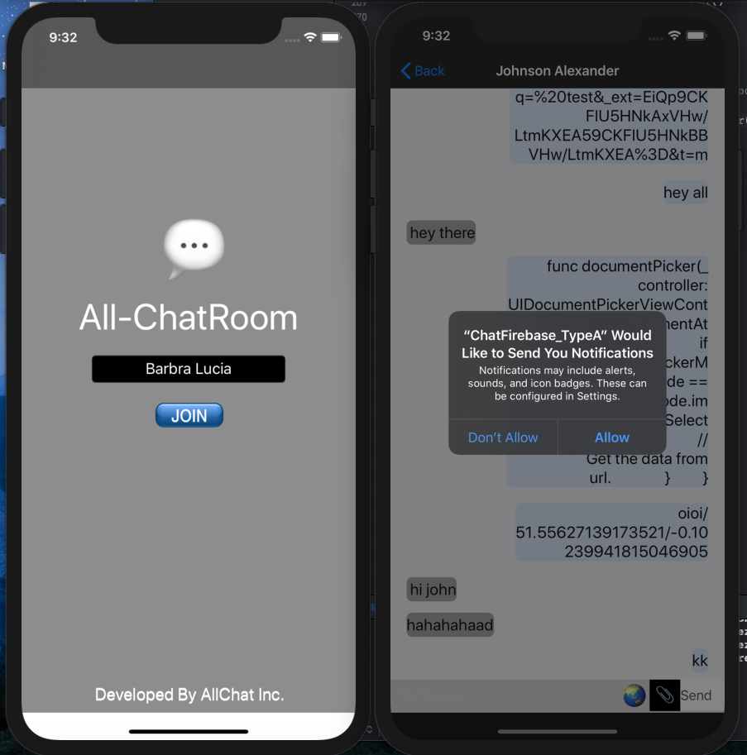
Login Screen (Dark-Mode)
Notifications
Login
1st Theme

Slide 9
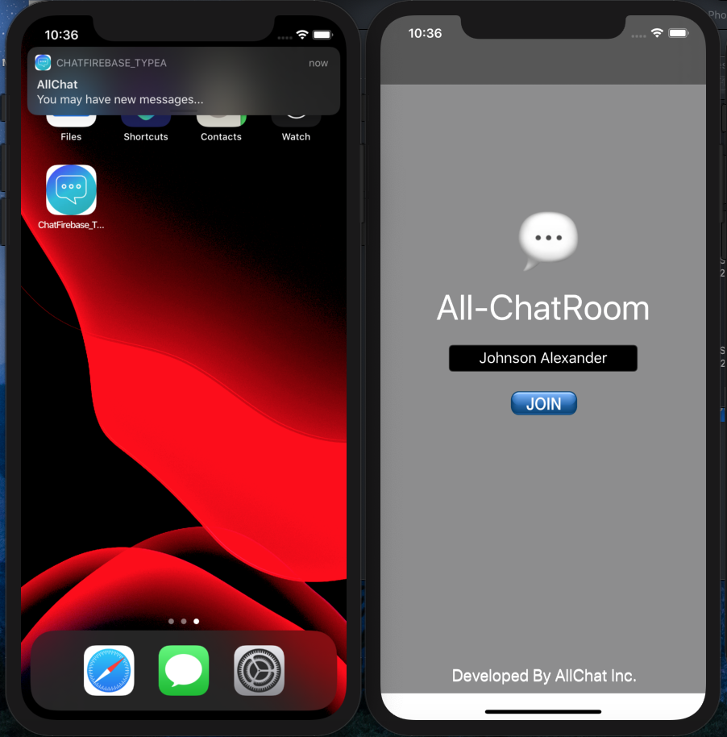
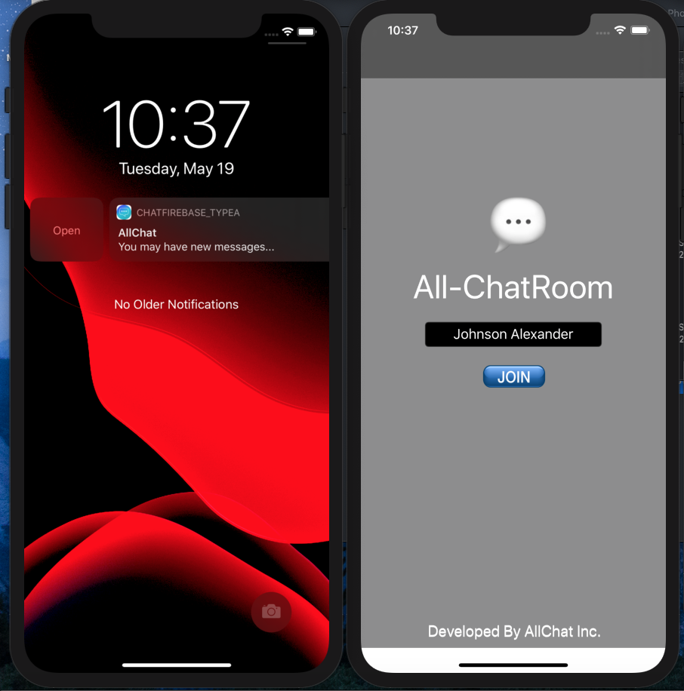
Notifications
Appears upon app exit
Leads back to app login page

Slide 10
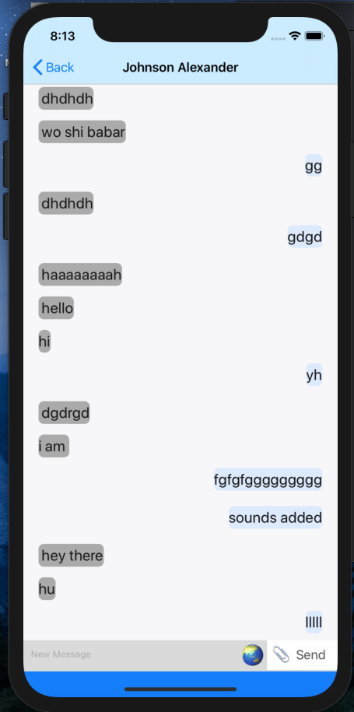
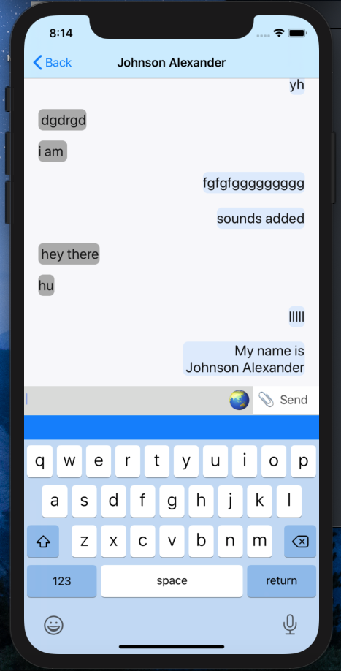
Messages
Default Theme
User name as title
Send Messages
Receive Messages
Messages stored Realtime Database – Google’s Firebase
Select Maps
Share Files

Slide 11
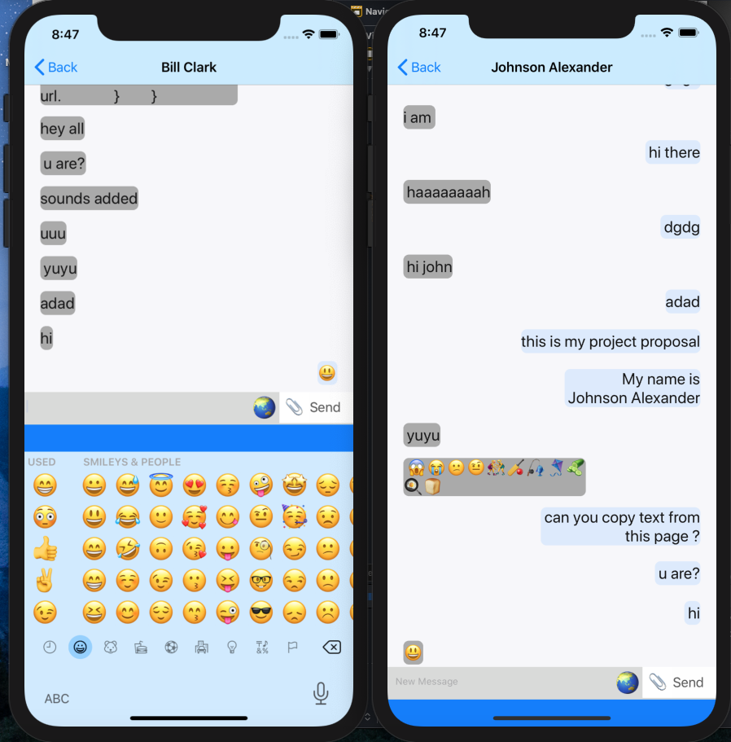

Slide 12
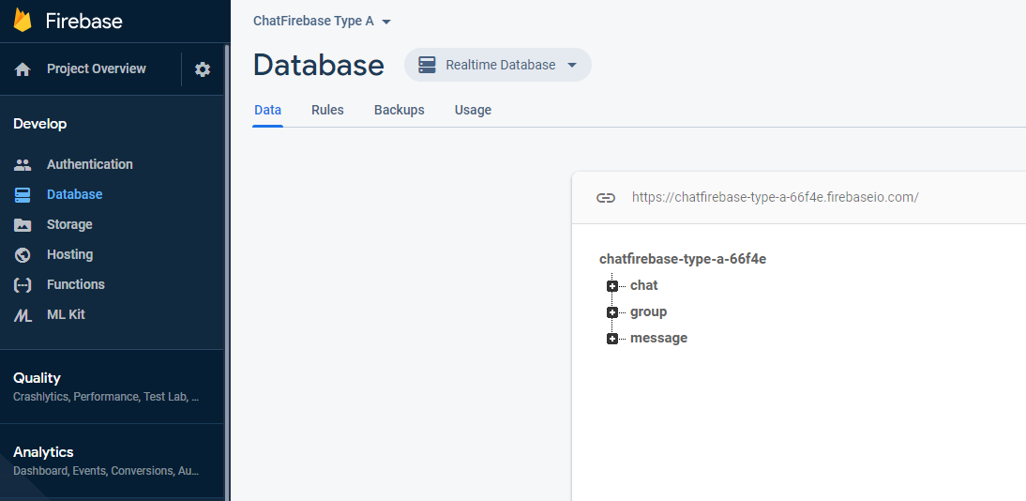

Slide 13
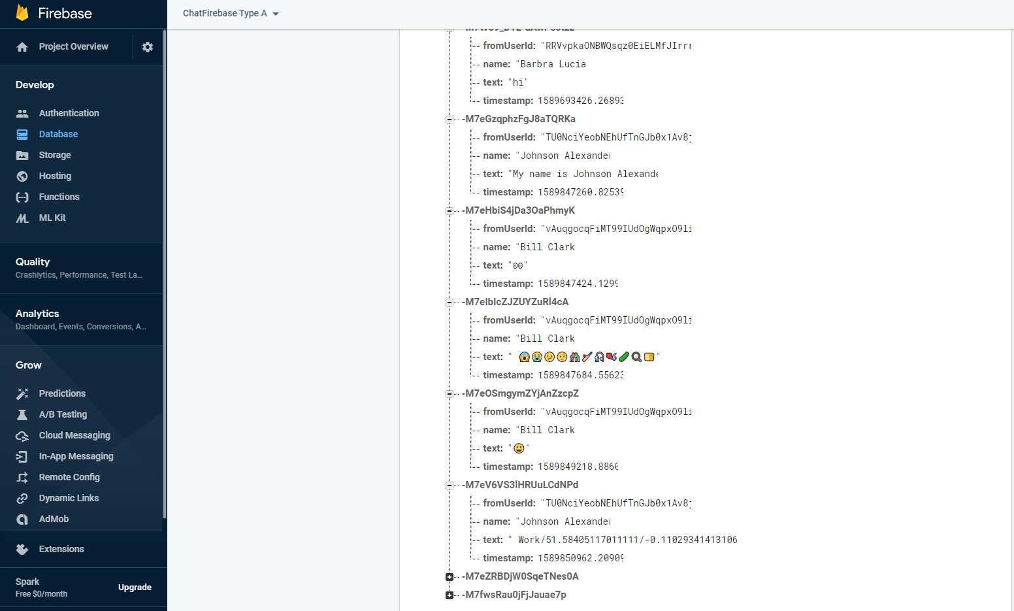

Slide 14
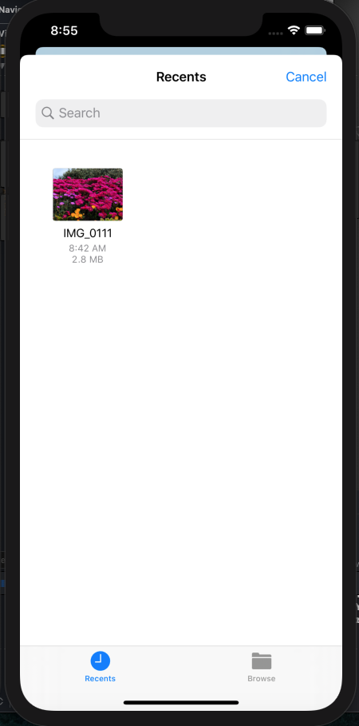
File Sharing
Select paperclip icon
Select File to Share
documentPicker
UIDocumentPickerViewController

Slide 15
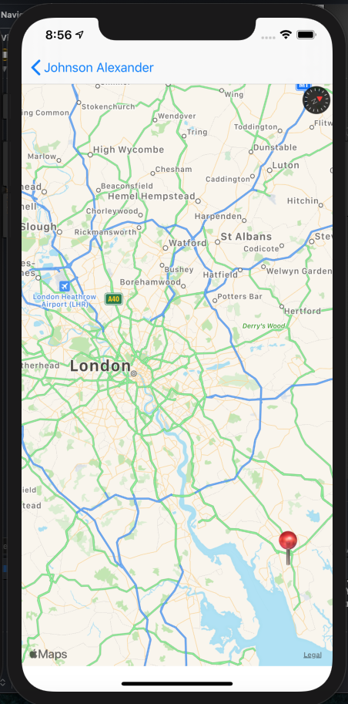
Maps
Utilizes Apple Maps
Add pins
Go to Apple Maps App
Live Location

Slide 16
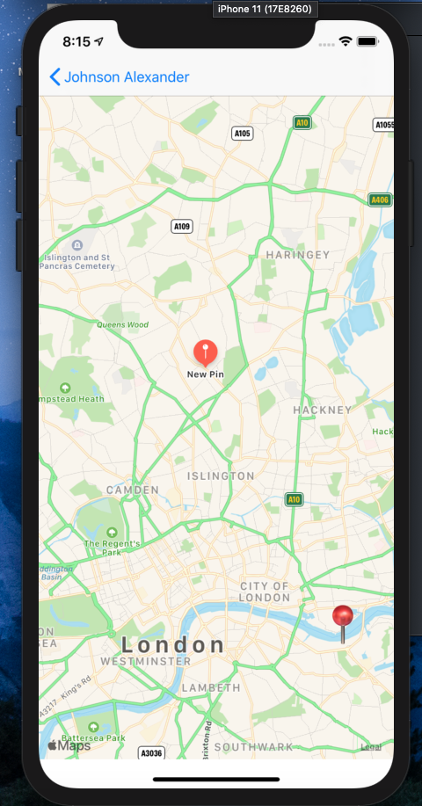
Maps
Added Pin
Share Location

Slide 17
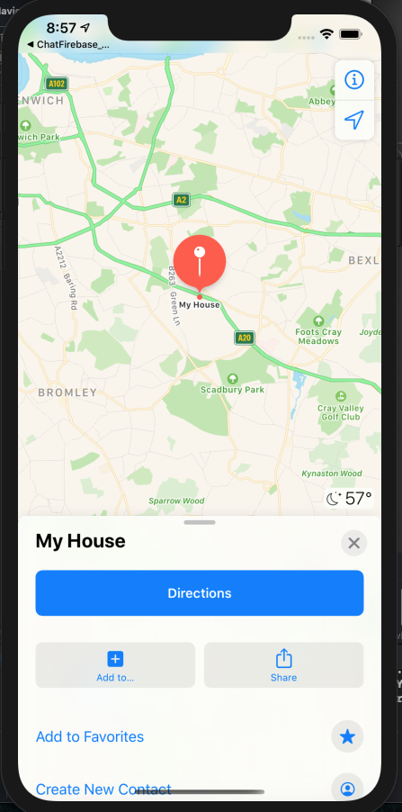
Maps
Added Pin Opened Through Apple Maps

Slide 18
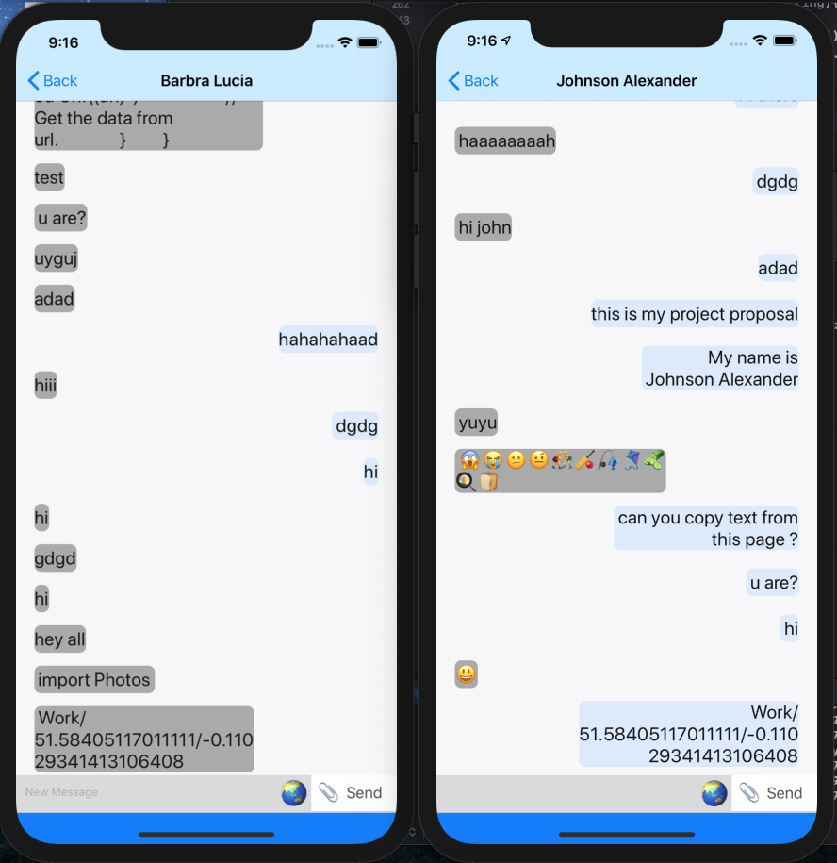
Maps
Location Shared – By Johnson

Slide 19
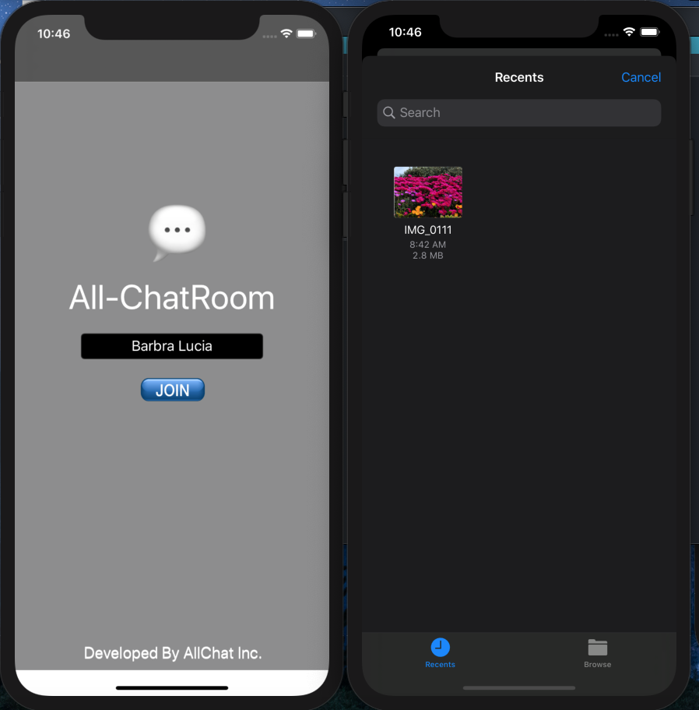
Theme
Dark theme enabled

Slide 20
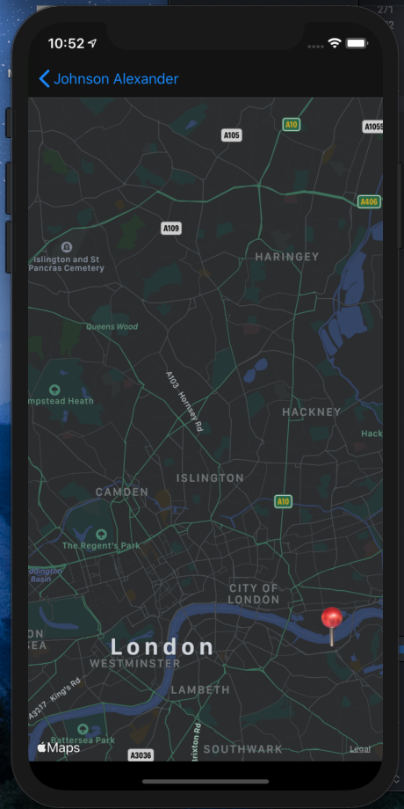
Theme
Dark theme enabled

Slide 21

All-ChatRoom Presentation

Slide 22

Questions?

